Slide 1

Bulma
Getting Started, Components and Layouts

Slide 2
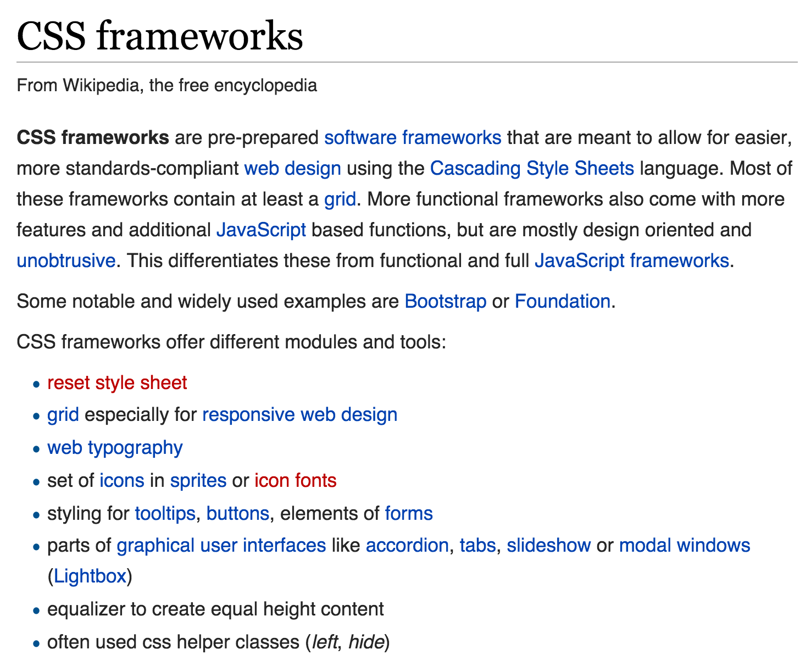


Slide 3
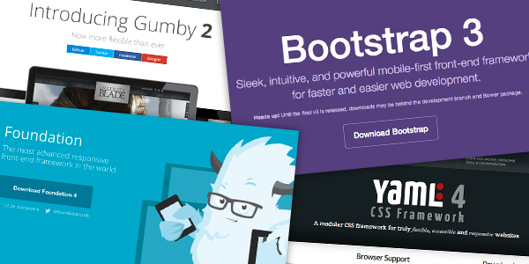
What is a CSS Framework?
“framework is defined as a package made up of a structure of files and folders of standardized code (HTML, CSS, JS etc.) which can be used to support the development of websites, as a basis to start building a site.”
“The aim of frameworks is to provide a common structure so that developers don’t have to redo it from scratch and can reuse the code provided"
http://www.awwwards.com/what-are-frameworks-22-best-responsive-css-frameworks-for-web-design.html

Slide 4
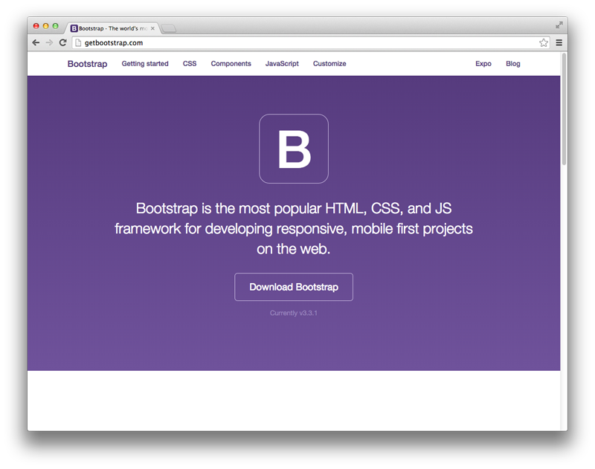
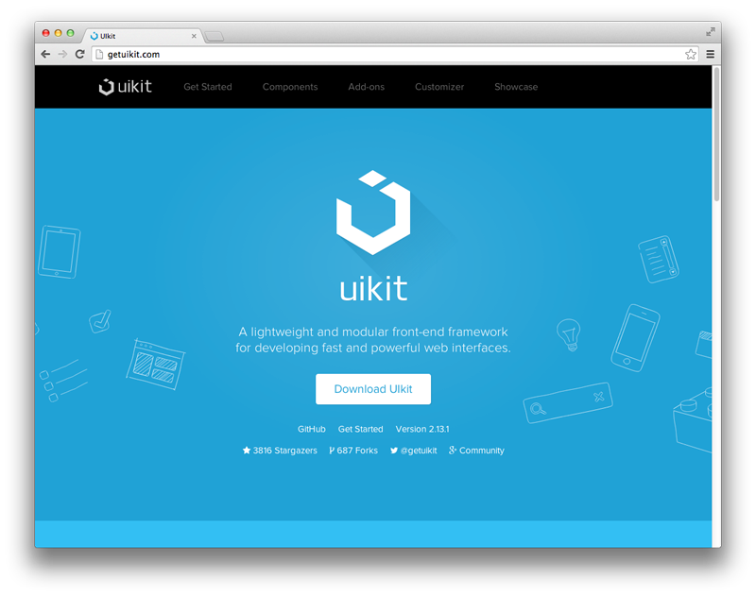
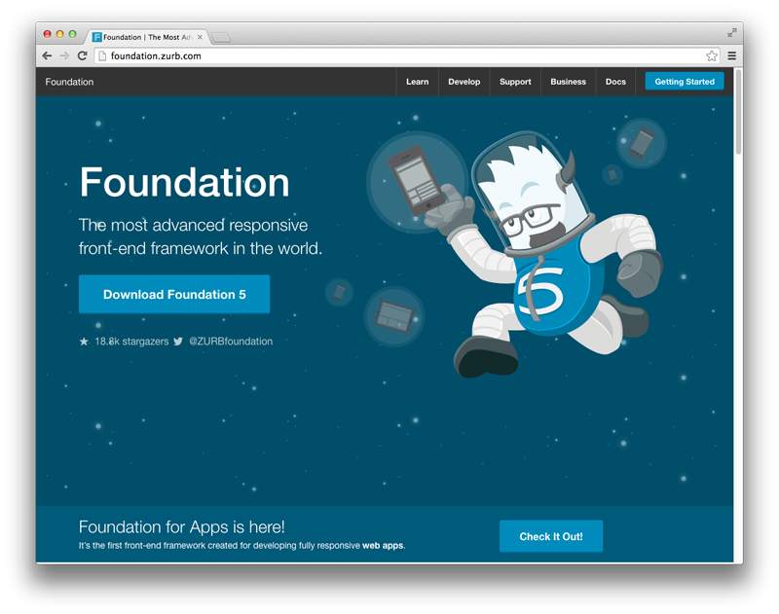
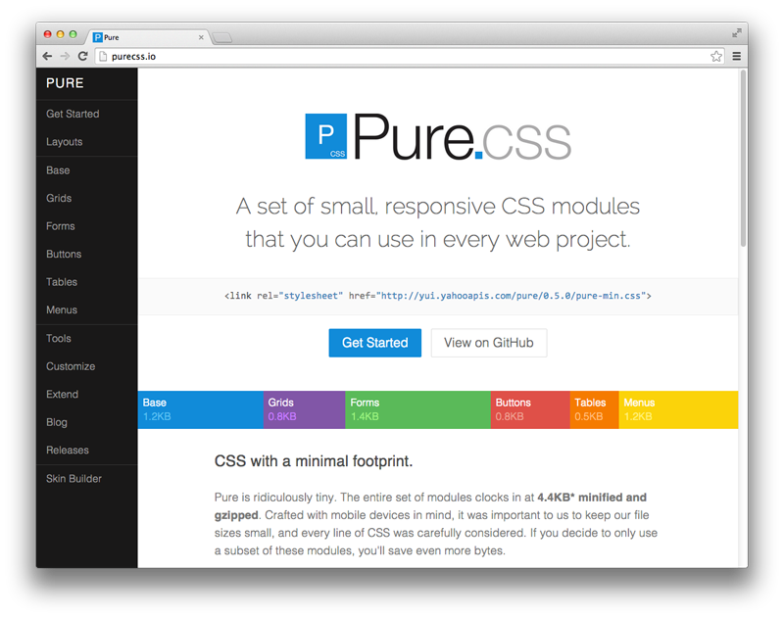
Popular Frameworks
http://www.sitepoint.com/5-most-popular-frontend-frameworks-compared/

Slide 5
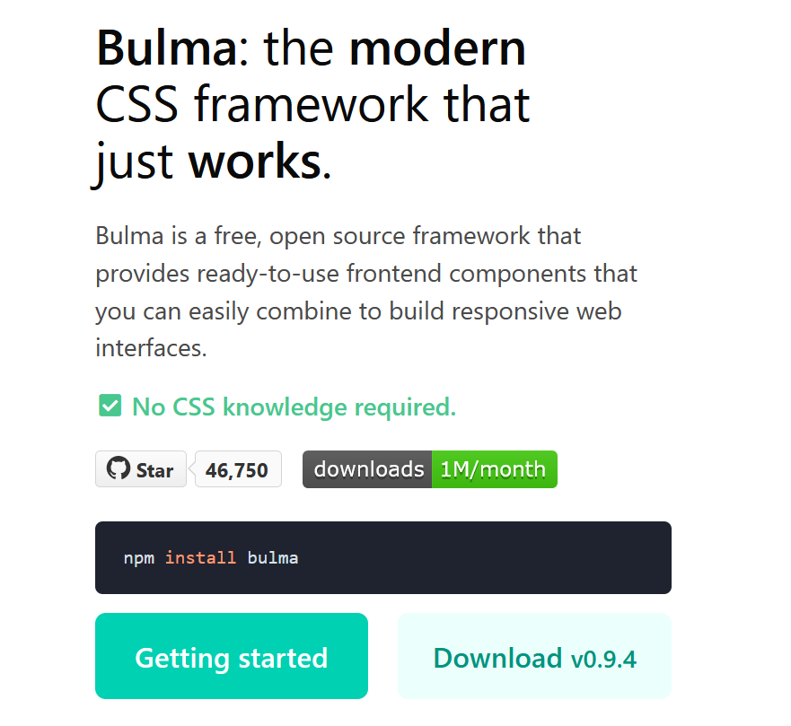

Slide 6
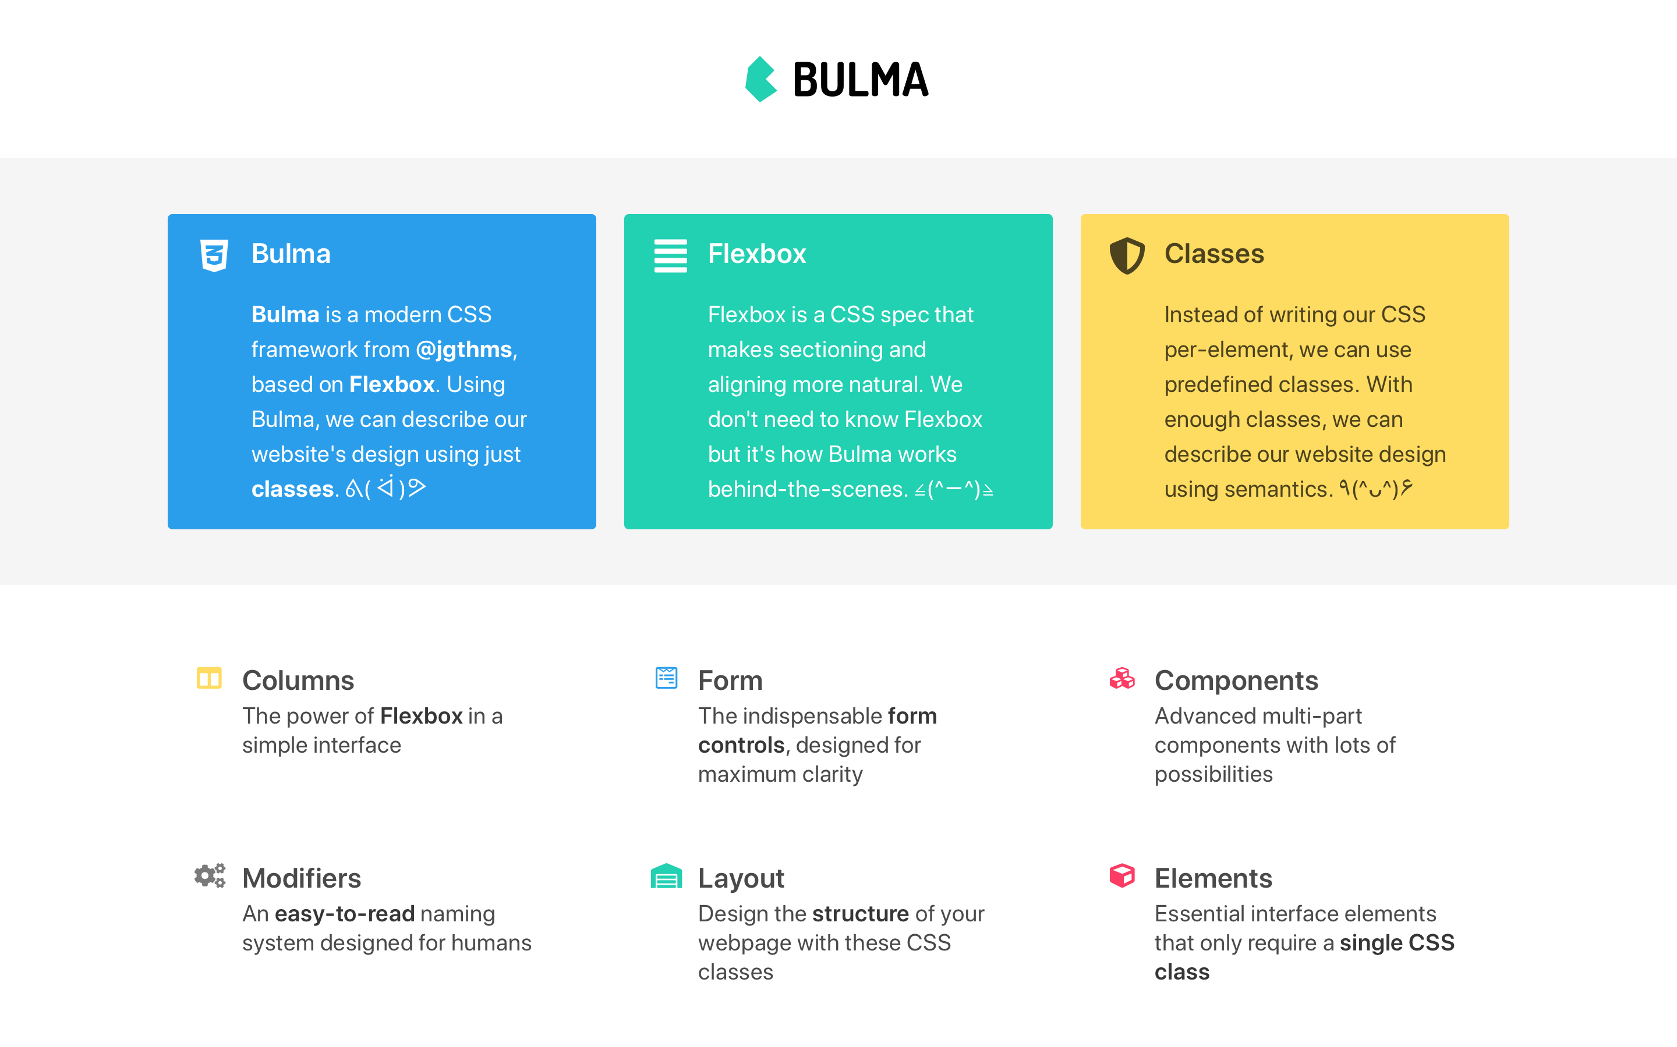

Slide 7
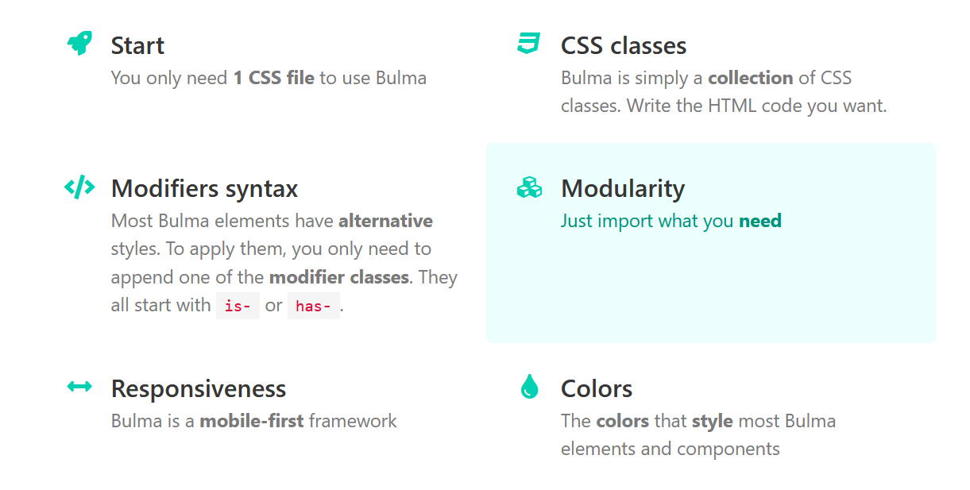

Slide 8
Bulma Starter
Bulma is a CSS library.
This means it provides CSS classes to help you style your HTML code
Bulma solely comprises CSS classes
Your HTML code has no impact on the styling of your page.
<section class="section"> <div class="container"> <h1 class="title"> Hello World </h1> <p class="subtitle"> My first website with <strong>Bulma</strong>! </p> </div> </section>

Slide 9
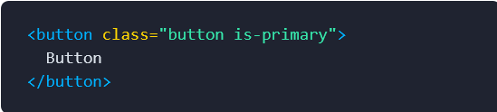
Modifiers
Most Bulma elements have alternative styles.
To apply them, you only need to append one of the modifier classes.
They all start with is- or has-Most Bulma elements have alternative styles.
To apply them, you only need to append one of the modifier classes.
They all start with is- or has-

Slide 10
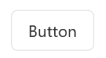
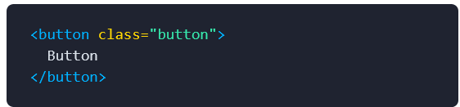

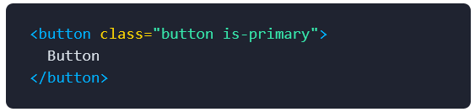
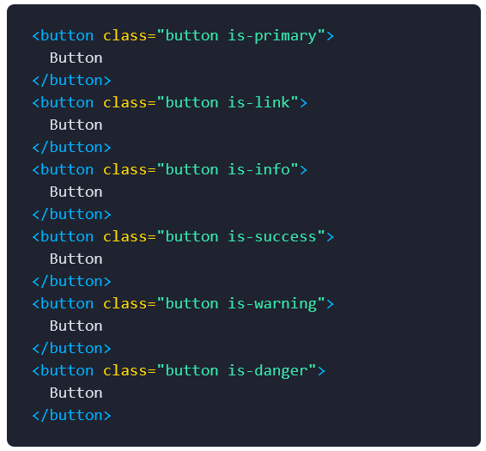
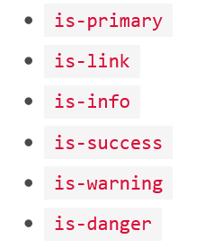
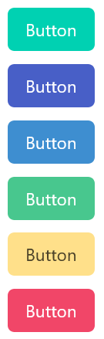
Modifier example
Let's start with a simple button that uses the "button" CSS class:
By adding the "is-primary" CSS class, you can modify the color:
You can use one of the 6 main colors:

Slide 11
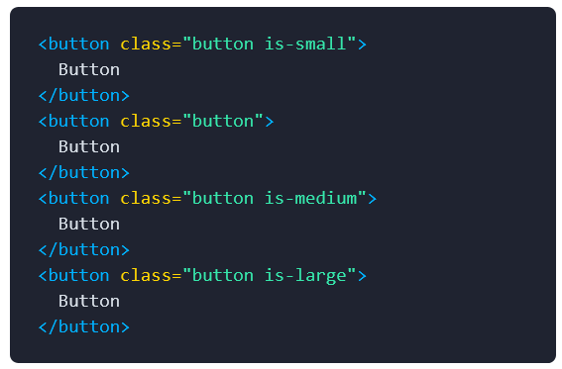
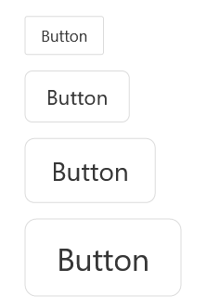
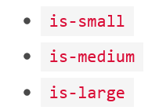
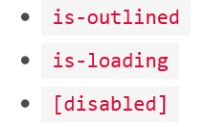
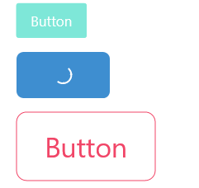
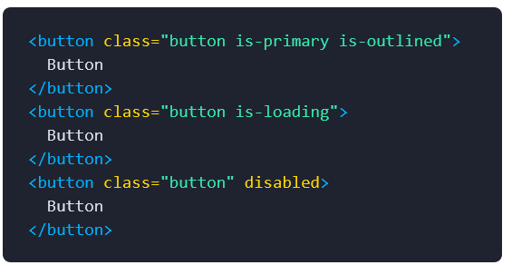
Modifier example
You can also alter the size:
Or the style or state:

Slide 12
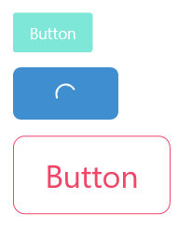
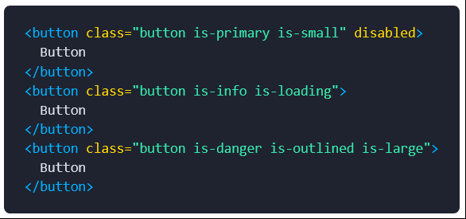
Modifier example
As a result, it's very easy to combine modifiers:

Slide 13
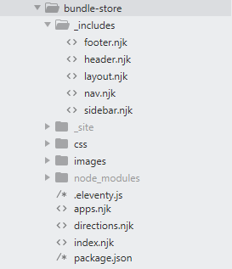
Project Structure
Eleventy.js
Includes
CSS
Images
Pages
Package.json
_site

Slide 14
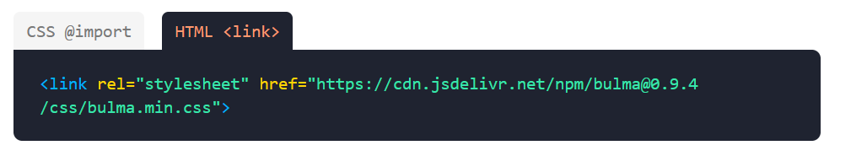
Incorporating Bulma into the project
You can import the CSS file directly from jsDelivr
This makes all of the Bulma components available on your webpage
<link rel="stylesheet" href="https://cdn.jsdelivr.net/npm/bulma@0.9.4/css/bulma.min.css">

Slide 15
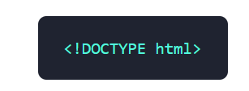
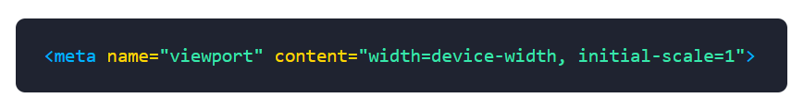
Bulma Setup
For Bulma to work correctly, you need to make your webpage responsive
Use the HTML5 doctype
Add the responsive viewport meta tag

Slide 16
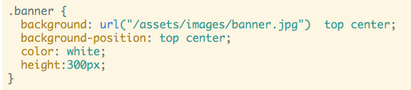
First Steps - remove existing stylesheet
Delete almost all CSS rules we have built up in the page so far
Leave just the ‘banner’ rule:

Slide 17
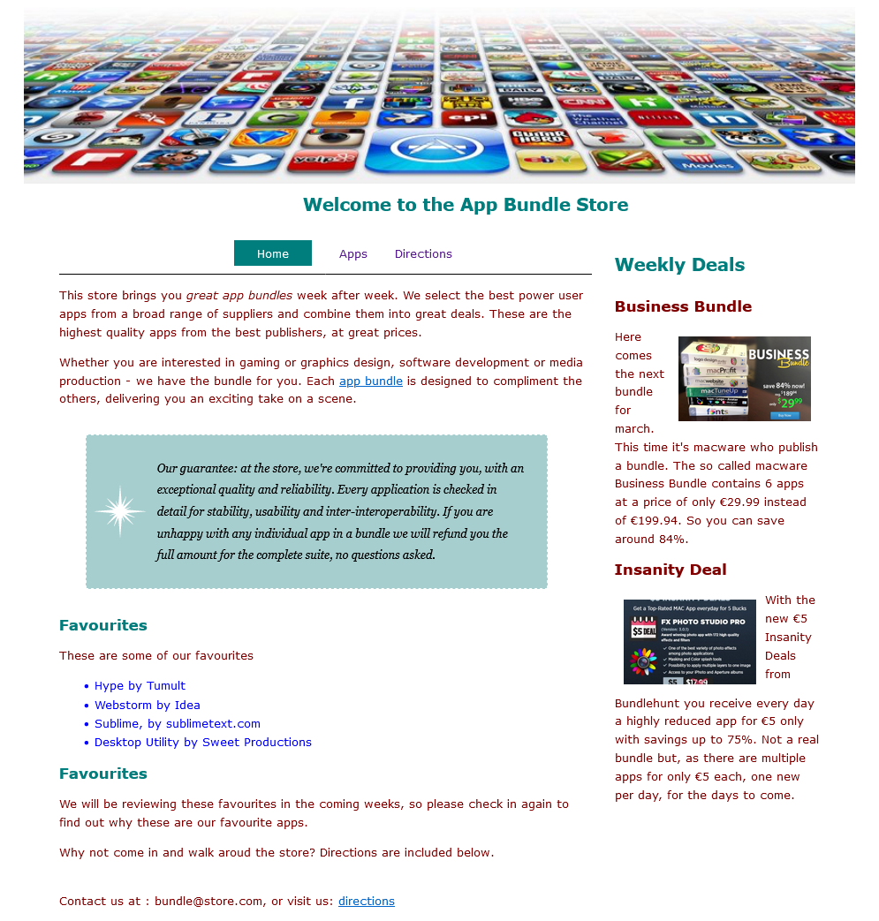
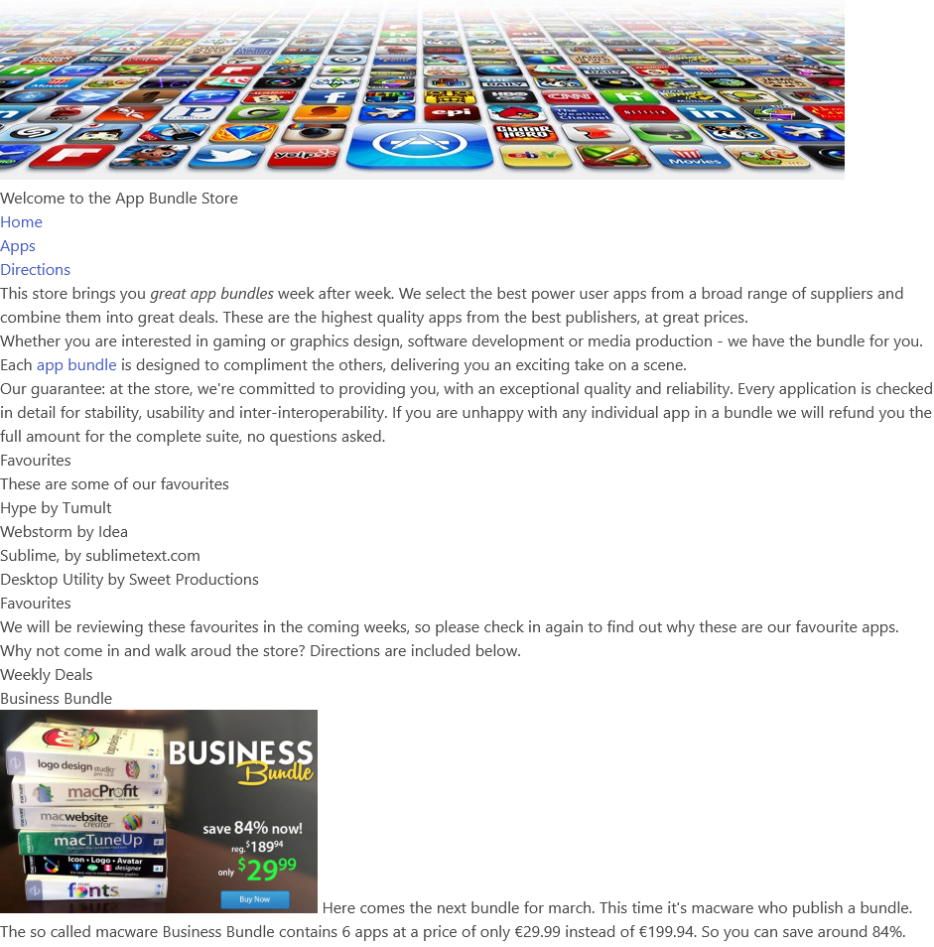

Slide 18
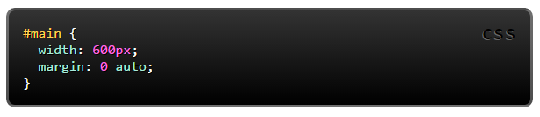
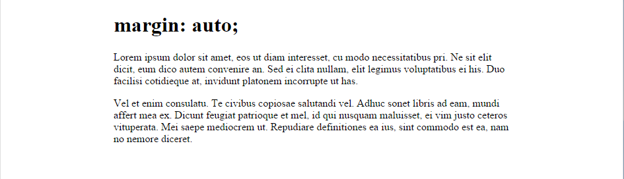
margin: auto;
Setting the width of a block-level element will stop it stretching out to the edges left and right. Then set the margin to auto left and right. This horizontally centres that element within its container.

Slide 19
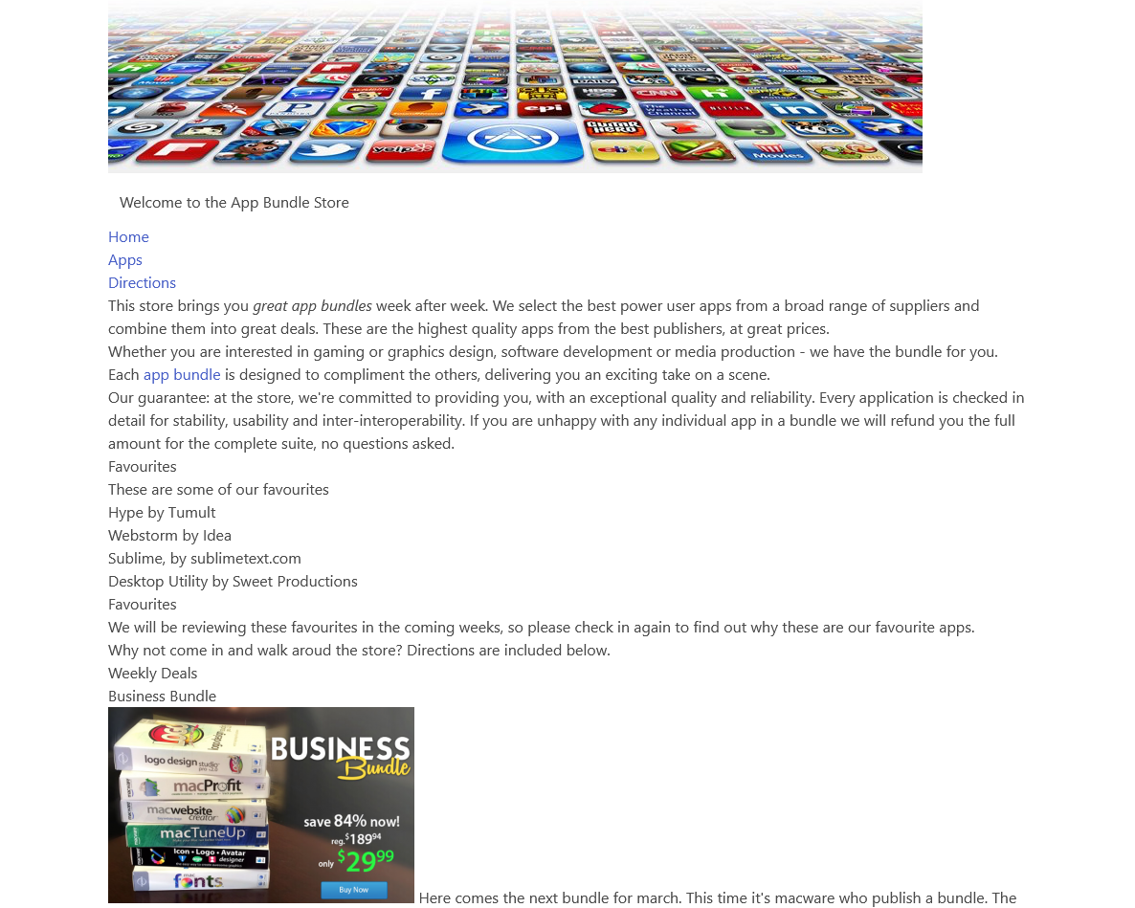
ui container
Replaces the need for “margin:auto” if we are using Bulma

Slide 20
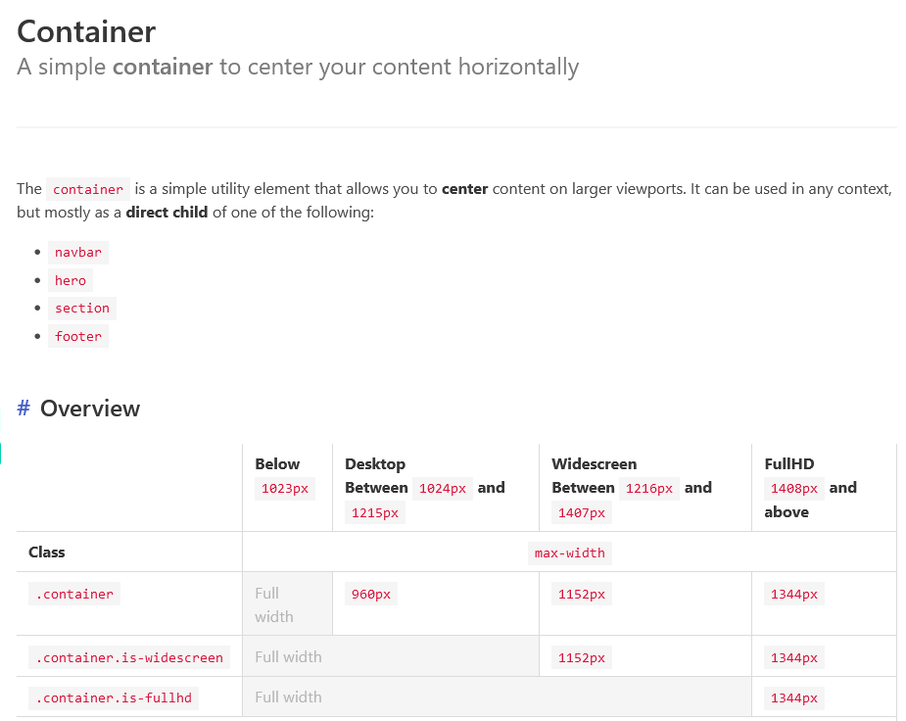
Containers
https://bulma.io/documentation/layout/container/

Slide 21
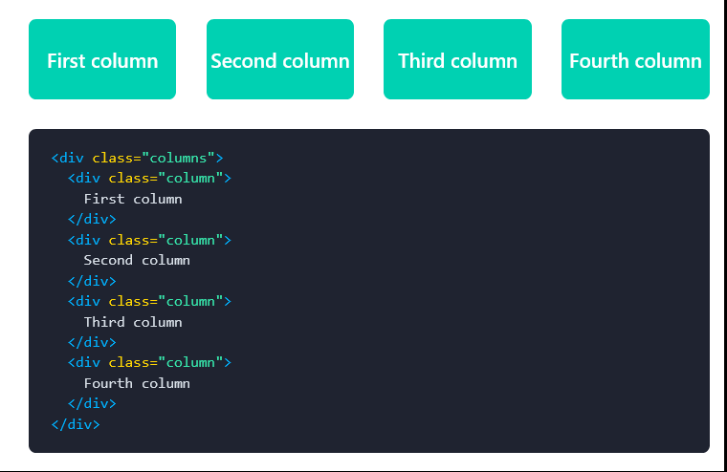
Bulma Columns
Bulma has its own grid system called Columns which is powered by Flexbox
It is a very simple way to build responsive grid based web pages
Building a column layout is very simple:
Add a columns container
Add as many column elements as you want
Each column will have an equal width, no matter the number of columns.

Slide 22
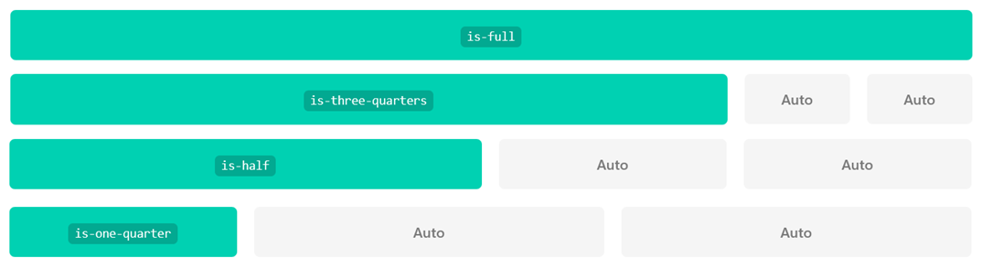
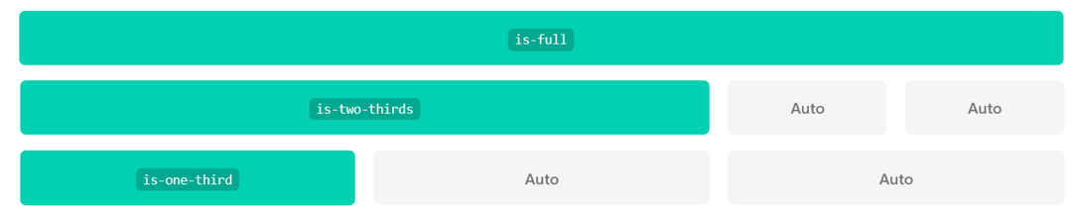
Column Sizes
Quarters
Define the size of each column individually
If you want to change the size of a single column, you can use one of the following modifier classes:
Thirds
is-full
is-three-quarters
is-half
Is-one-quarter

Slide 23
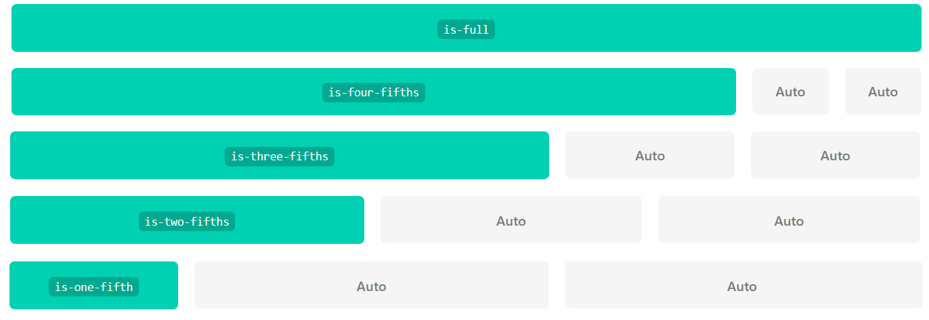
Column Sizes
The other columns will fill up the remaining space automatically.
You can use the following multiples of 20% as well:
is-full-width
is-four-fifths
is-three-fifths
is-two-fifths
is-one-fifth

Slide 24
Column Sizes
The other columns will fill up the remaining space automatically.
You can use the following multiples of 20% as well:
is-full-width
is-four-fifths
is-three-fifths
is-two-fifths
is-one-fifth

Slide 25
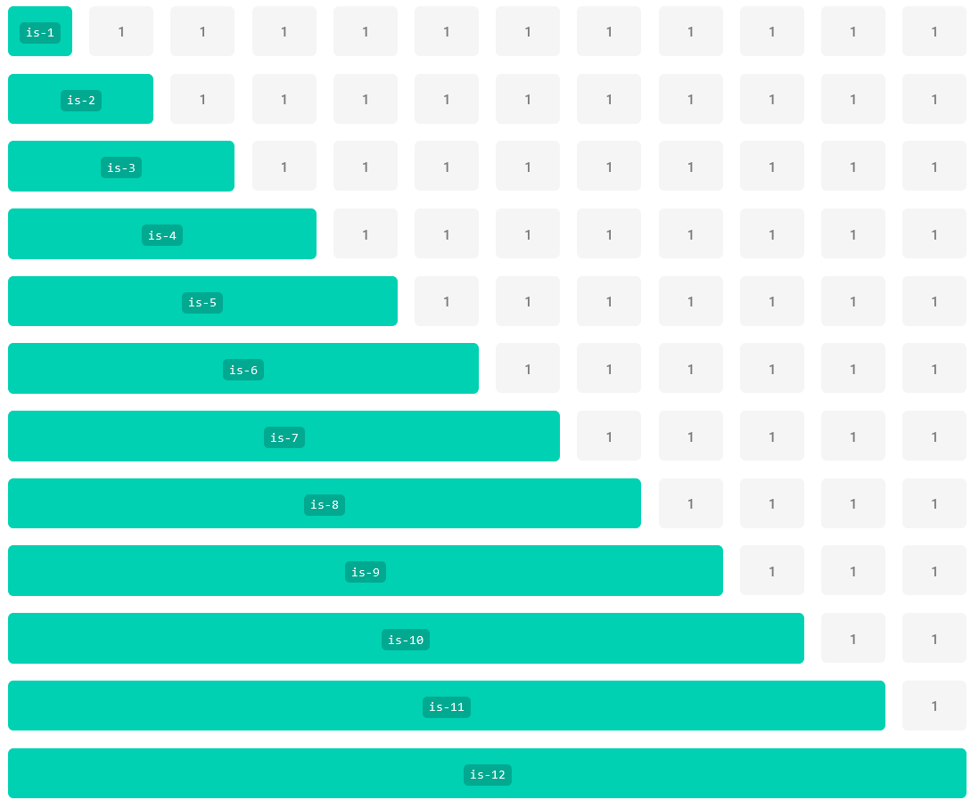
Column Sizes
Each modifier class is named after how many columns you want out of 12. So if you want 7 columns out of 12, use is-7.
You can also use a 12 column grid with the following modifiers:
is-1
is-2
is-3
is-4
is-5
is-6
is-7
is-8
is-9
is-10
is-11
is-12

Slide 26
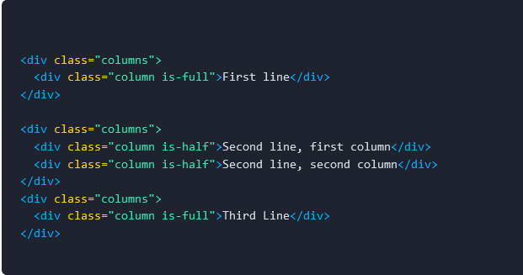
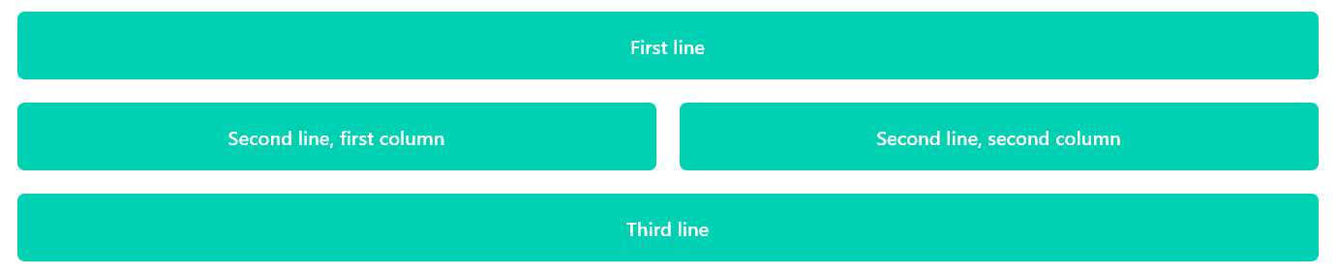
Column Rows
The full width makes up a line. New lines can be created in one of two ways:
1. Each columns class is counted as a new line. You will need a new columns parent element for each row of columns.

Slide 27
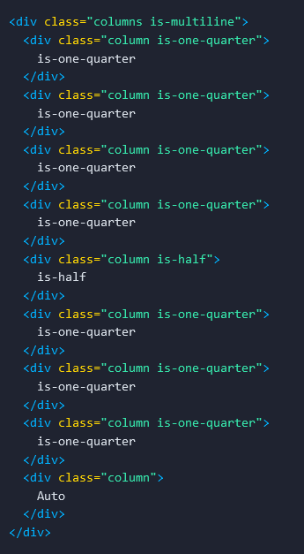
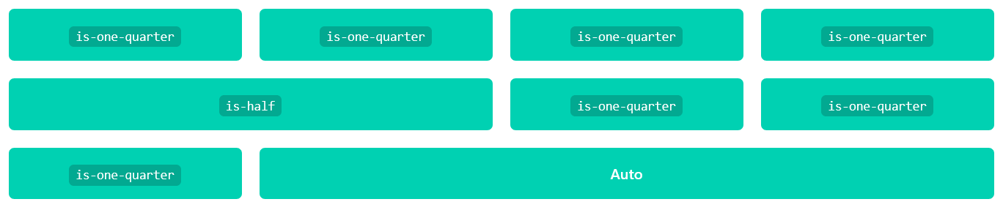
Column Multiline
2. Using the multiline modifier allows your columns to flow onto new lines when there is not enough room on the current line

Slide 28
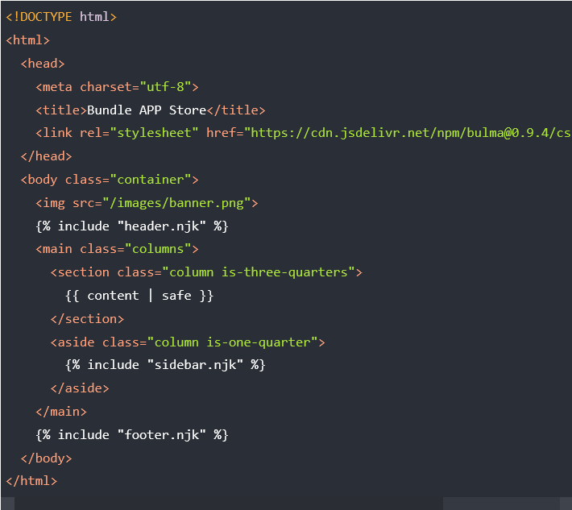
Columns
We are going to add columns to <header>, <main> and footer.

Slide 29
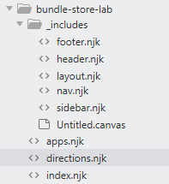
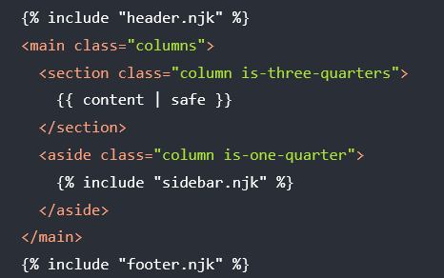
Modifying _layout.njk
_layout defines the structure of all pages in the bundle store folder
Any change here effects all of the pages

Slide 30
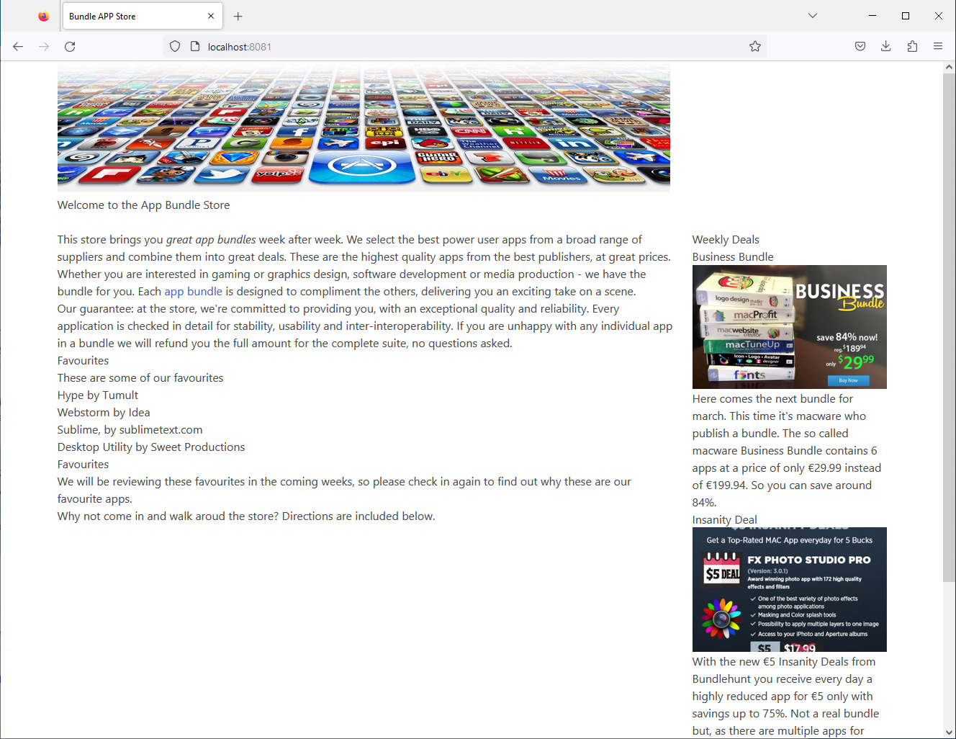

Slide 31
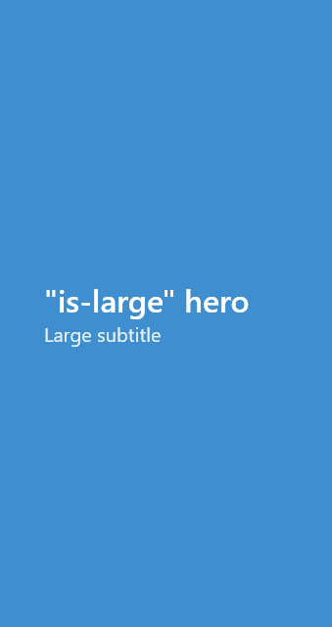

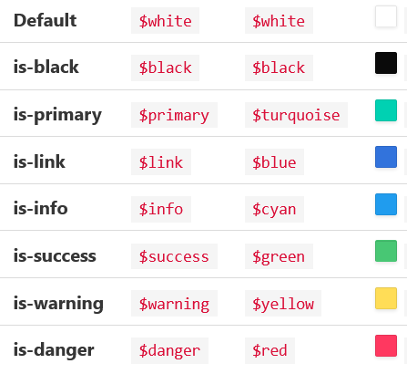



Bulma Hero
Bulma CSS Framework layouts give us options for several common content areas such as Hero banners and Footers
Heros come in 8 different colours Heros also come in 6 different sizes

Slide 32


Slide 33

Bulma Hero with Navbar

Slide 34


Bundle App Hero

Slide 35


Bulma Footer
A simple responsive footer which can include anything: lists, headings, columns, icons, buttons, etc
The Bulma footer is a simple container, with lots of bottom padding, making it great as the last element of any webpage

